Slide 1
Securing Windows 10 Native Defence Features

Slide 2

PS C:\> $env:USERNAME Alex Bytes
Senior Infrastructure Specialist
Looks after ‘all the things’
Blogger of IT
ByteSizedAlex.com - Byte sized for when a nibble just isn't enough!
Twitter - @ByteSizedAlex
Slides available: ByteSizedAlex.com & GitHub.com/bytesizedalex

Slide 3
Set-Expectation –Confirm $true
This isn’t a technical deep dive – hopefully you will want to learn more by the end of this talk with a view to deploying features not currently used in your estate ☺
Assumption: You are using Windows 10 Enterprise/Pro

Slide 4
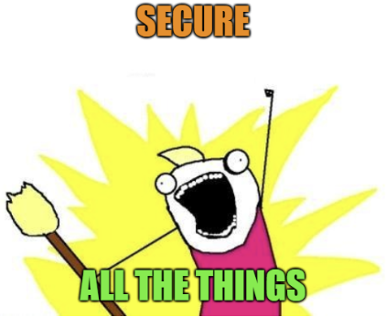
Defensive Features (others exist ☺)
Encryption
Secure Boot/Trusted Boot/Measured Boot
Credential Guard
Application Guard (WDAG)
Exploit Guard
Windows Sandbox (preview)
AppLocker and Device Guard
Much of the EMET (Enhanced Mitigation Experience Toolkit) functionality is now baked into Windows 10 along with additional enhancements and improvements
Windows Defender may be required in some cases

Slide 5
Encryption – Not Just Mobile Devices!
Most organisations encrypt mobile/portable devices
Encrypt your desktops!
Anyone with offline access to the machine can modify files and mitigate protection measures
BitLocker with TPM and IOMMU (Intel VT-d) to protect against DMA attacks. Escrow keys to Active Directory

Slide 6
Securing The Boot Process
Secure Boot
Supported devices ensure only trusted, signed code is used to boot
Trusted Boot
Windows validates the integrity of OS components as they are loaded
Early Launch Anti-Malware (ELAM)
Scan drivers as they are loaded to prevent unapproved drivers
Measured Boot (Health Attestation)
Create and provide health attestation data to centralised servers
Those systems can then allow or deny access to resources based on health report
Reference: https://docs.microsoft.com/en-us/windows/security/information-protection/secure-the-windows-10-boot-process

Slide 7
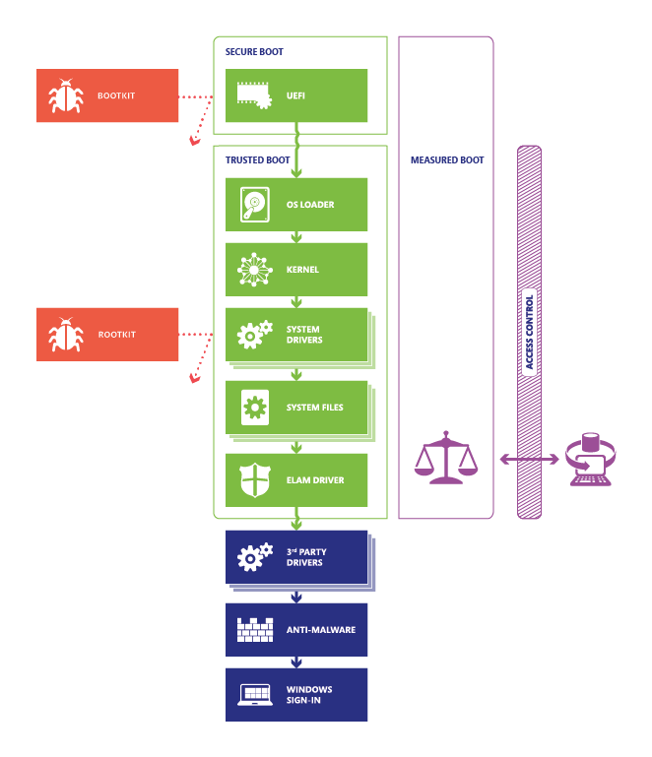
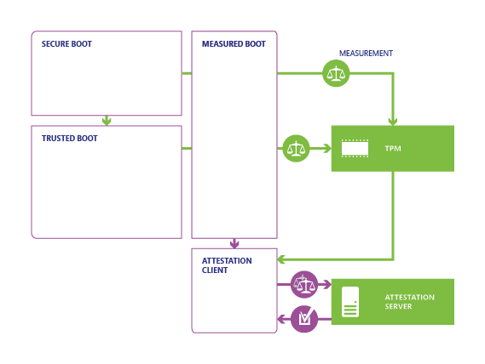

Slide 8

Virtualisation Based Security (VBS)
Some of the features we are going to talk about leverage ‘Virtualisation Based Security’ (VBS) – you may also hear the term Virtual Secure Mode (VSM)
VBS/VSM is an important foundation which we need to discuss briefly to understand how these ‘Guards’ do the fancy business
How do the thing?

Slide 9
Processor Protection Rings
RING 3 – User mode code runs here
RING 0 – Highest Privilege level (traditionally), kernel mode
RING 1 and 2 typically unused. You may hear of ‘minus’ rings as well
RING -1 (Hypervisor)
RING -2 (System Management Mode - SMM)
Note: There aren’t really new minus rings, it’s still R0 but leveraging specific processor functions to control access

Slide 10
Ring Level Privileges
While the previous slide diagram is typically used to represent ring levels I feel the below is easier to digest
I would describe ring levels as providing ‘vertical’ privilege levels
Lower Privilege
RING 3 | USER MODE
RING 2
RING 1
RING 0 | KERNEL MODE
RING -1 | HYPERVISOR
RING -2 | SMM
Higher Privilege

Slide 11


Slide 12
New Privilege Model
We need a new way of defining privilege/trust levels
Virtual Trust Level – VTL
Integer based (0, 1, etc)
Higher VTL number = greater privilege/trust
Currently two VTL levels, spec allows for additional VTL levels as required
VTL 0 – Normal Mode/World
VTL 1 – Secure Mode/World
VTL is hardware enforced – control who can READ/WRITE/EXECUTE (RWX) memory regions via EPT/SLAT
Require Secure Boot and IOMMU (DMA protection)

Slide 13
Virtual Trust Level (VTL)
We can describe Virtual Trust Levels as providing horizontal privilege, or a way of defining new isolation boundaries
Remember – currently we only have 2 VTL levels, 0 and 1 however the specification allows for additional VTL levels if required
VTL 0
VTL 1
VTL 2
VTL …
Lower Privilege
Higher Privilege

Slide 15
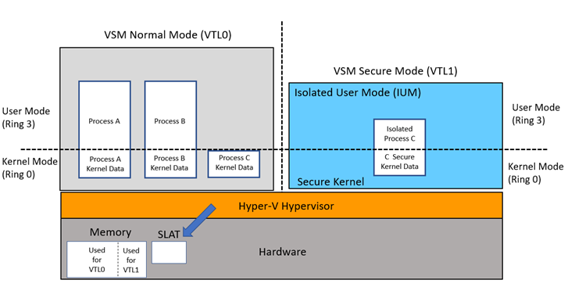
Isolated User Mode (IUM) Processes
Reference: https://docs.microsoft.com/en-us/windows/desktop/procthread/isolated-user-mode--ium--processes

Slide 16
Ring Levels and VTL Domains
Think of it like this –
Ring levels define POWER / PRIVILEGE
VTL’s define ISOLATION
The hypervisor controls access to resources (memory, registers etc) and in combination with the secure kernel facilitates access by the regular kernel to allowed resources (e.g read a memory region)
Check hardware requirements as some functions require CPU extensions – where these do not exist those functions may fall back to ‘software’ mode which can have a performance impact

Slide 17
Credential Guard
We need to safely store secrets (user credentials/hashes)
Regular kernel is not a safe space – once we have gained local admin through exploit, we can elevate to SYSTEM and dump LSASS
Credential Guard utilises VBS to safely store secrets in IUM
We don’t have time in this talk but carefully read how to deploy and enforce and don’t assume this is 100% credential protection!

Slide 18
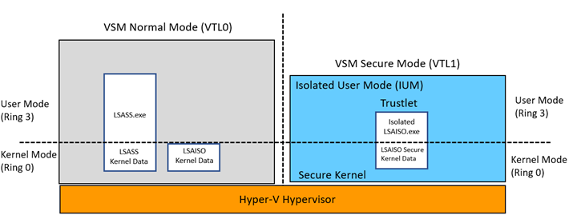
Credential Guard – LSASS and LSAISO
Reference: https://docs.microsoft.com/en-us/windows/desktop/procthread/isolated-user-mode--ium--processes

Slide 19
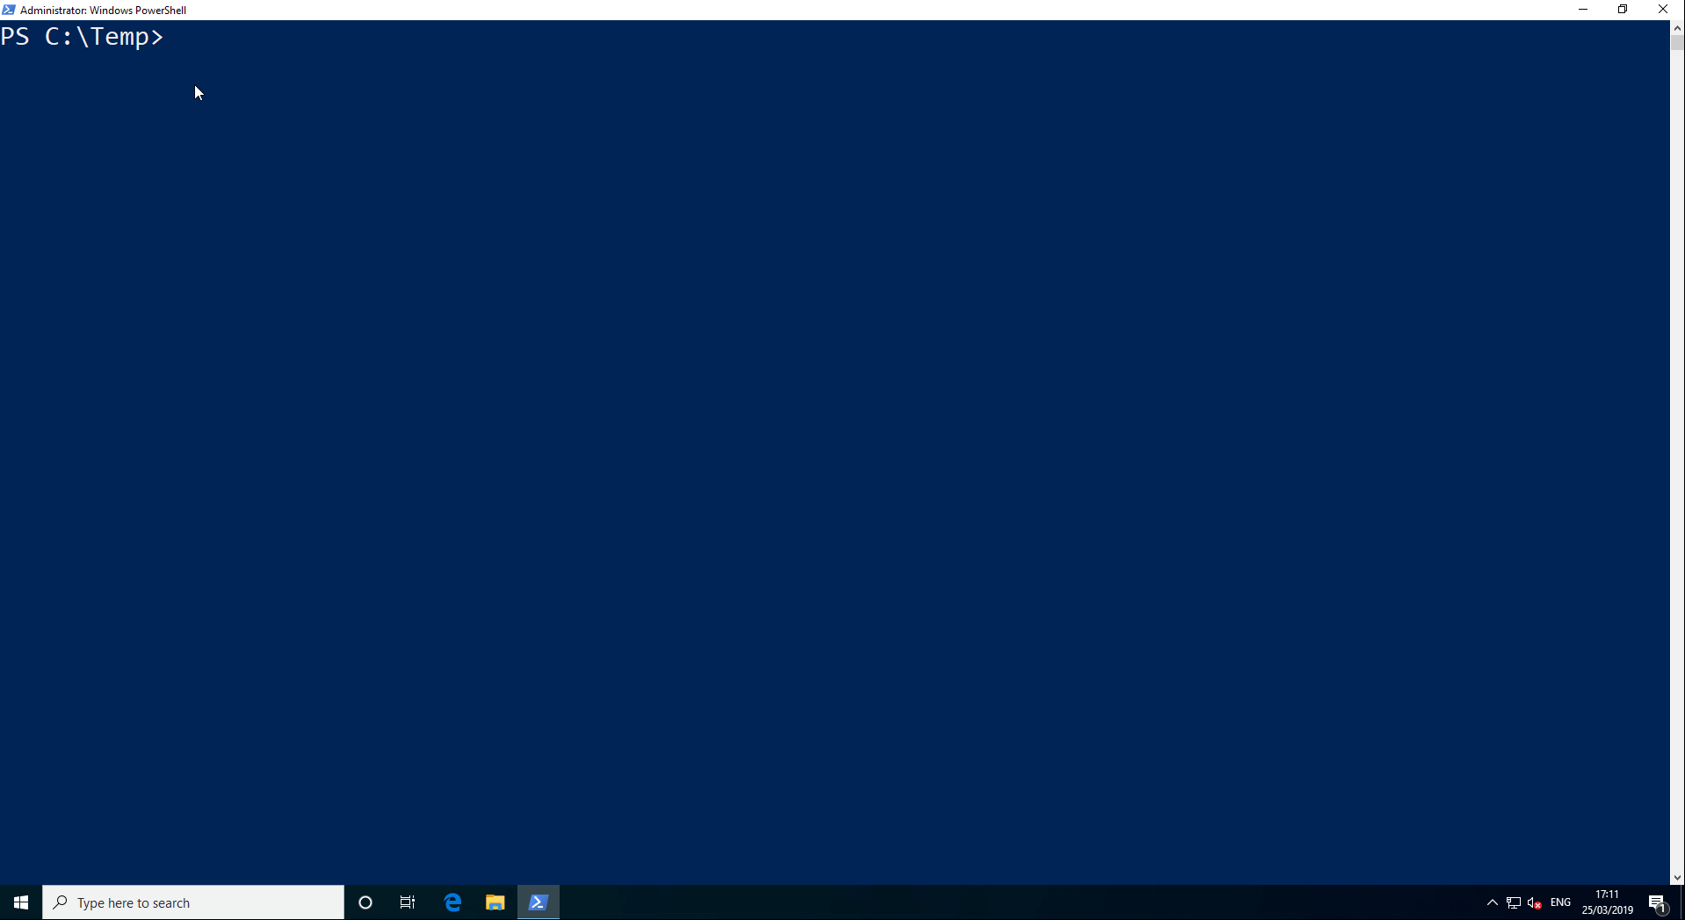
LSASS/LSAISO Memory Dump Demo

Slide 20
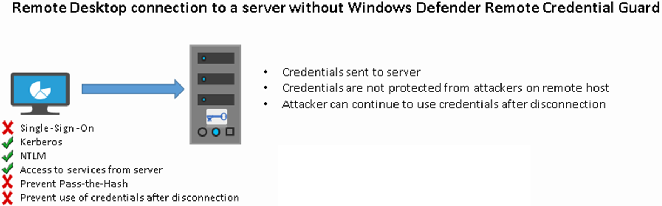
Remote Credential Guard
Reference: https://docs.microsoft.com/en-gb/windows/security/identity-protection/remote-credential-guard

Slide 21
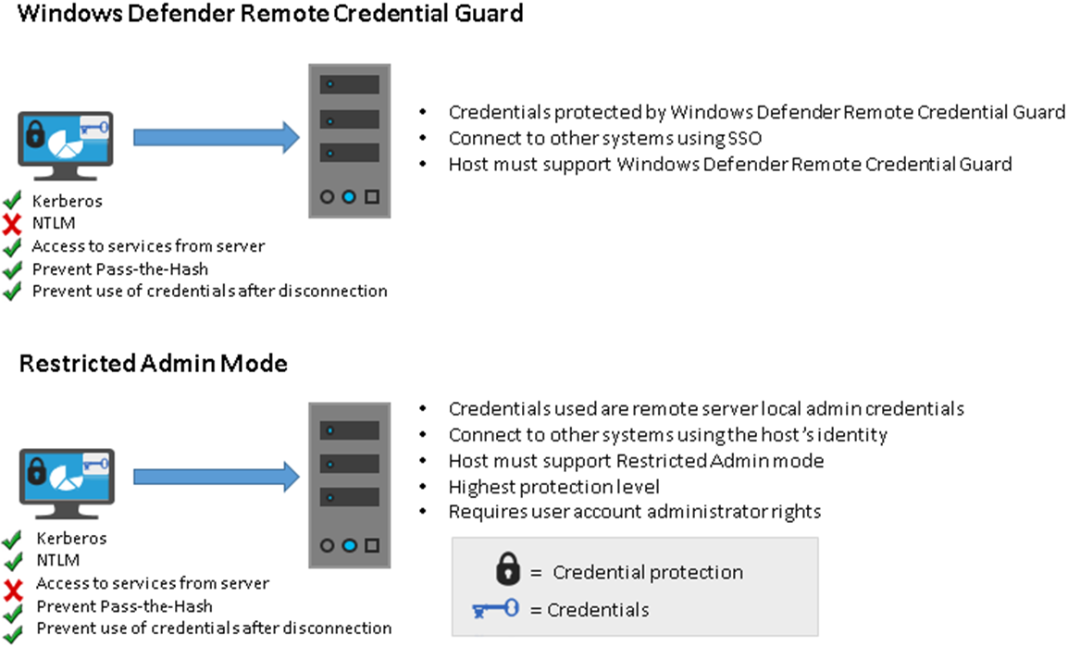
Remote Credential Guard
Reference: https://docs.microsoft.com/en-gb/windows/security/identity-protection/remote-credential-guard

Slide 22
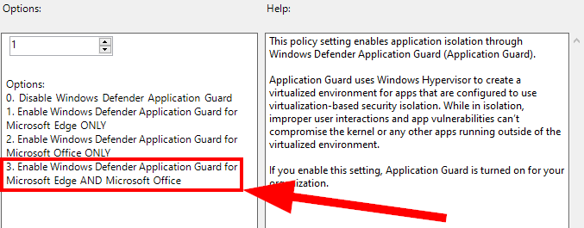
Windows Defender Application Guard (WDAG)
Leveraging Hyper-V virtualisation we can isolate an application in a containerised instance
Microsoft Edge browser can be triggered to run as a WDAG container
Container blocked from accessing local network resources
GPO references MS Office as well – unable to find documentation at this time

Slide 23
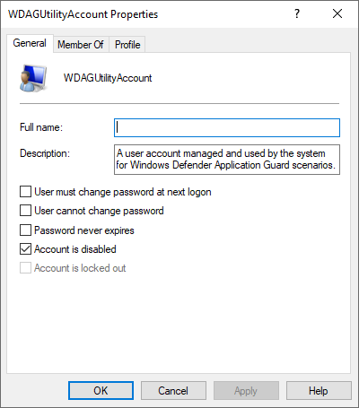
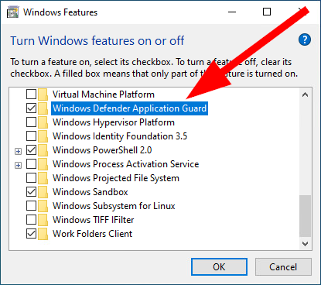
WDAG Installation
Add/Remove Windows Features
PowerShell
Enable-WindowsOptionalFeature -Online -FeatureName 'Windows-Defender-ApplicationGuard'

Slide 24
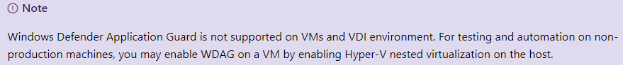
WDAG VM/VDI Support
Please be aware Microsoft state WDAG inside a VM is not supported
This doesn’t mean it can’t be configured to work, you just won’t get any support from them
Hopefully this will change in future releases however it would be very dependent on your setup due to the requirement for nested virtualisation

Slide 25
WDAG Edge Deployment Scenarios
WDAG Edge can be deployed in two modes
Standalone Mode
Enterprise Managed Mode
Standalone Mode requires the user to manually launch WDAG Edge
Enterprise Managed Mode allows IT services to configure trusted sites and enforce WDAG Edge for all other sites
When configured properly, WDAG Edge can be launched when users are browsing with Internet Explorer as well

Slide 26
WDAG Edge Process Flow

Slide 27
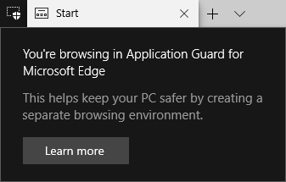

WDAG Edge Demo
Launch Edge and browse to a ‘trusted’ site as defined by our Group Policy
Observe that the site loads in our standard host based Edge session
Browse to a site not listed in our Enterprise safe list
Observe that a WDAG Edge container instance is launched and the website is rendered in isolation
Browse to an Enterprise safe list site from our WDAG Edge container
Observe that the site is loaded in our standard host based Edge session

Slide 28
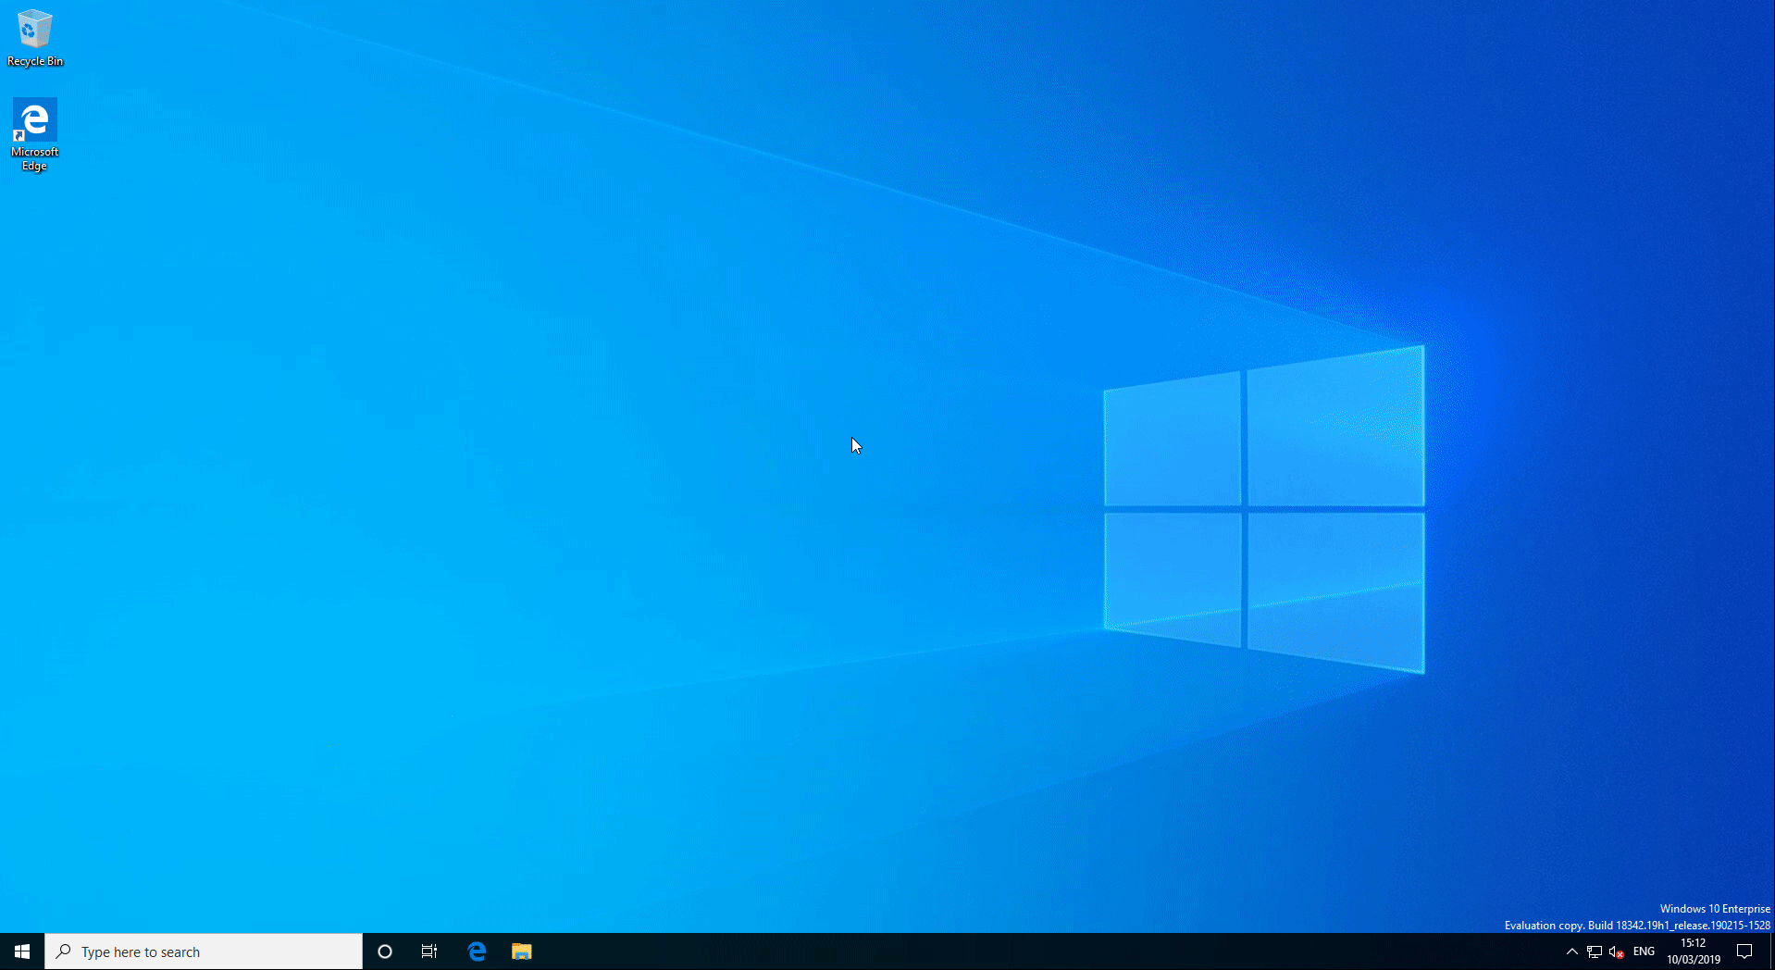

Slide 29
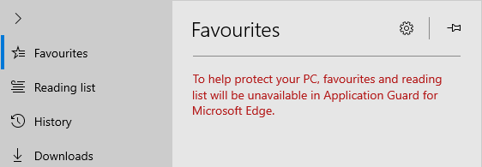
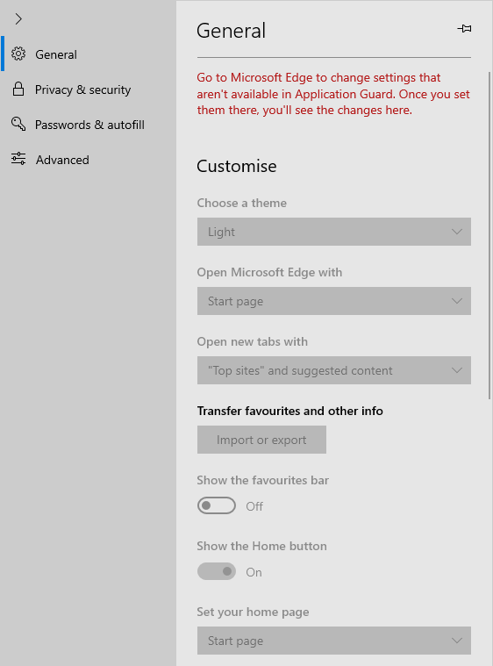
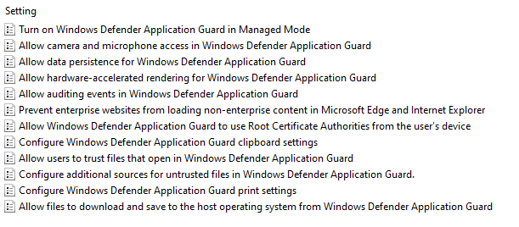
WDAG Edge Restrictions
Some functionality may be restricted or blocked
For example: Favourites, General Settings
We can define via GPO what can be copied in or out of the container

Slide 30
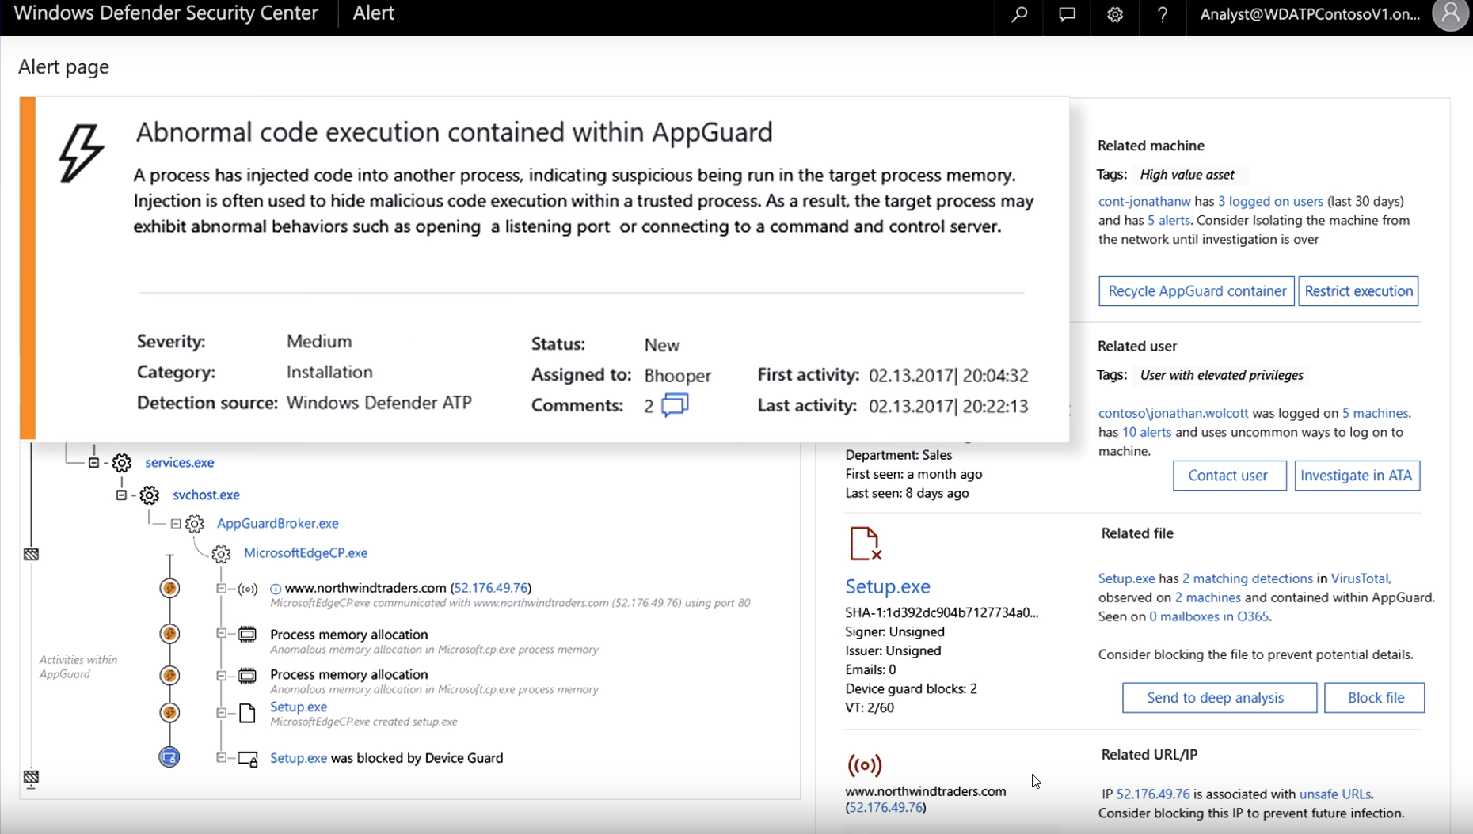
WDAG Edge Windows Defender ATP
WDAG Edge Containers support Windows Defender ATP integration and notification

Slide 31
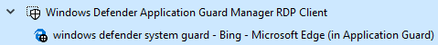
WDAG Container Bonus Points
If you’re wondering how we are actually accessing and viewing the containerised Edge instance…

Slide 32
Windows Defender Exploit Guard
Comprised of 4 main features
Exploit protection
Apply exploit mitigation techniques to apps your organization uses, both individually and to all apps. Works with third-party antivirus solutions and Windows Defender Antivirus (Windows Defender AV)
Attack surface reduction rules
Reduce the attack surface of your applications with intelligent rules that stop the vectors used by Office-, script- and mail-based malware. Requires Windows Defender AV
Network protection
Extends the malware and social engineering protection offered by Windows Defender SmartScreen in Microsoft Edge to cover network traffic and connectivity on your organization's devices. Requires Windows Defender AV
Controlled folder access
Helps protect files in key system folders from changes made by malicious and suspicious apps, including file-encrypting ransomware malware. Requires Windows Defender AV
Reference: https://docs.microsoft.com/en-us/windows/security/threat-protection/windows-defender-exploit-guard/windows-defender-exploit-guard

Slide 33
Exploit Guard Windows Defender AV Requirements
Feature | Real-time protection
Exploit protection | No requirement
Attack surface reduction rules | Must be enabled
Network protection | Must be enabled
Controlled folder access | Must be enabled
Reference: https://docs.microsoft.com/en-us/windows/security/threat-protection/windows-defender-exploit-guard/windows-defender-exploit-guard

Slide 34
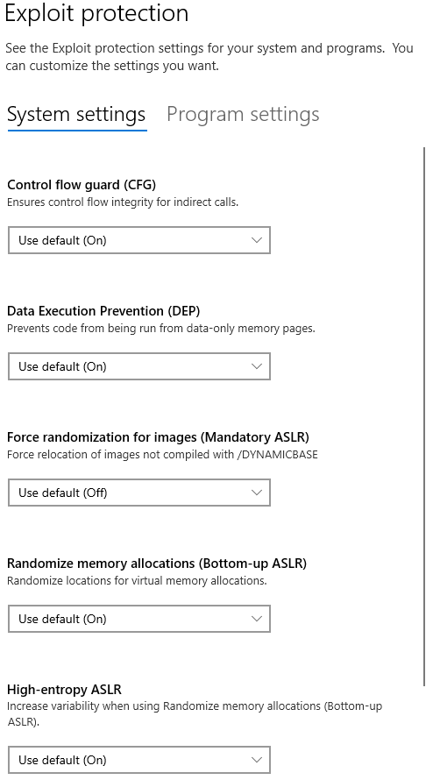
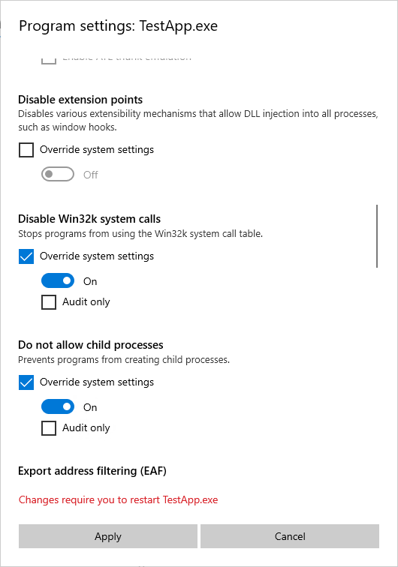
Exploit Guard – Exploit Protection

Slide 35
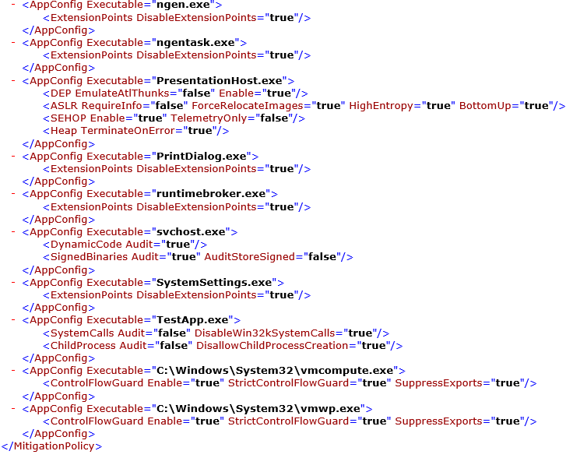
Exploit Guard – Exploit Protection
Use the Windows Security app to configure rules then export option to create XML file or via PowerShell
Get-ProcessMitigation
Set-ProcessMitigation

Slide 36
Mitigation | Description | Can be applied to
Control flow guard (CFG) | Ensures control flow integrity for indirect calls. Can optionally suppress exports and use strict CFG. | System and app-level
Data Execution Prevention (DEP) | Prevents code from being run from data-only memory pages such as the heap and stacks. Only configurable for 32-bit (x86) apps, permanently enabled for all other architectures. Can optionally enable ATL thunk emulation. | System and app-level
Force randomization for images (Mandatory ASLR) | Forcibly relocates images not compiled with /DYNAMICBASE. Can optionally fail loading images that don't have relocation information. | System and app-level
Randomize memory allocations (Bottom-Up ASLR) | Randomizes locations for virtual memory allocations including those for system structures heaps, stacks, TEBs, and PEBs. Can optionally use a wider randomization variance for 64-bit processes. | System and app-level
Validate exception chains (SEHOP) | Ensures the integrity of an exception chain during exception dispatch. Only configurable for 32-bit (x86) applications. | System and app-level
Validate heap integrity | Terminates a process when heap corruption is detected. | System and app-level
Arbitrary code guard (ACG) | Prevents the introduction of non-image-backed executable code and prevents code pages from being modified. Can optionally allow thread opt-out and allow remote downgrade (configurable only with PowerShell). | App-level only
Block low integrity images | Prevents the loading of images marked with Low Integrity. | App-level only
Block remote images | Prevents loading of images from remote devices. | App-level only
Block untrusted fonts | Prevents loading any GDI-based fonts not installed in the system fonts directory, notably fonts from the web. | App-level only
Code integrity guard | Restricts loading of images signed by Microsoft, WHQL, or higher. Can optionally allow Microsoft Store signed images. | App-level only
Disable extension points | Disables various extensibility mechanisms that allow DLL injection into all processes, such as AppInit DLLs, window hooks, and Winsock service providers. | App-level only
Disable Win32k system calls | Prevents an app from using the Win32k system call table. | App-level only
Do not allow child processes | Prevents an app from creating child processes. | App-level only
Export address filtering (EAF) | Detects dangerous operations being resolved by malicious code. Can optionally validate access by modules commonly used by exploits. | App-level only
Import address filtering (IAF) | Detects dangerous operations being resolved by malicious code. | App-level only
Simulate execution (SimExec) | Ensures that calls to sensitive APIs return to legitimate callers. Only configurable for 32-bit (x86) applications. Not compatible with ACG | App-level only
Validate API invocation (CallerCheck) | Ensures that sensitive APIs are invoked by legitimate callers. Only configurable for 32-bit (x86) applications. Not compatible with ACG | App-level only
Validate handle usage | Causes an exception to be raised on any invalid handle references. | App-level only
Validate image dependency integrity | Enforces code signing for Windows image dependency loading. | App-level only
Validate stack integrity (StackPivot) | Ensures that the stack has not been redirected for sensitive APIs. Not compatible with ACG | App-level only

Slide 37
Exploit Guard Attack Surface Reduction
Rules that allow us to control what applications can do
For example, block Office files from creating child processes and accessing APIs
Block Adobe Reader from creating child processes
When configured correctly these rules can greatly diminish the common attack vectors used
Think of them like pre-built Exploit Protection rules tailored for specific applications and use cases

Slide 38
Exploit Guard Attack Surface Reduction (ASR) rules
Rule name | GUID
Block executable content from email client and webmail | BE9BA2D9-53EA-4CDC-84E5-9B1EEEE46550
Block all Office applications from creating child processes | D4F940AB-401B-4EFC-AADC-AD5F3C50688A
Block Office applications from creating executable content | 3B576869-A4EC-4529-8536-B80A7769E899
Block Office applications from injecting code into other processes | 75668C1F-73B5-4CF0-BB93-3ECF5CB7CC84
Block JavaScript or VBScript from launching downloaded executable content | D3E037E1-3EB8-44C8-A917-57927947596D
Block execution of potentially obfuscated scripts | 5BEB7EFE-FD9A-4556-801D-275E5FFC04CC
Block Win32 API calls from Office macro | 92E97FA1-2EDF-4476-BDD6-9DD0B4DDDC7B
Block executable files from running unless they meet a prevalence, age, or trusted list criterion | 01443614-cd74-433a-b99e-2ecdc07bfc25
Use advanced protection against ransomware | c1db55ab-c21a-4637-bb3f-a12568109d35
Block credential stealing from the Windows local security authority subsystem (lsass.exe) | 9e6c4e1f-7d60-472f-ba1a-a39ef669e4b2
Block process creations originating from PSExec and WMI commands | d1e49aac-8f56-4280-b9ba-993a6d77406c
Block untrusted and unsigned processes that run from USB | b2b3f03d-6a65-4f7b-a9c7-1c7ef74a9ba4
Block Office communication application from creating child processes | 26190899-1602-49e8-8b27-eb1d0a1ce869
Block Adobe Reader from creating child processes | 7674ba52-37eb-4a4f-a9a1-f0f9a1619a2c
Reference: https://docs.microsoft.com/en-us/windows/security/threat-protection/windows-defender-exploit-guard/attack-surface-reduction-exploit-guard

Slide 39
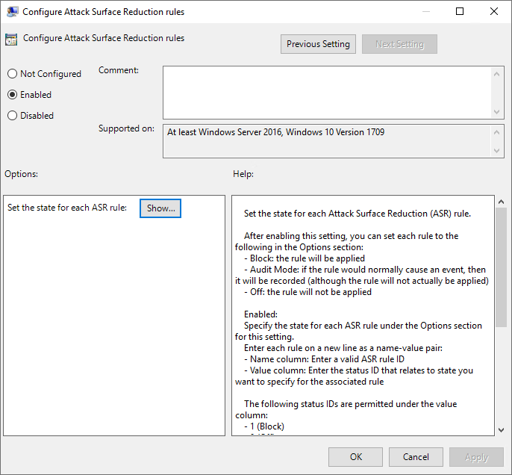
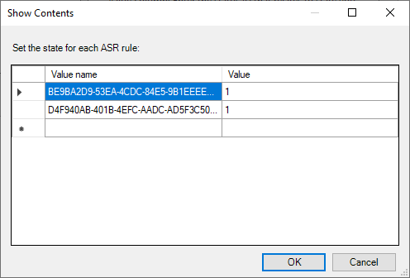
Exploit Guard ASR Rules Config
Set-MpPreference -AttackSurfaceReductionRules_Ids <rule ID> -AttackSurfaceReductionRules_Actions Enabled
Add-MpPreference -AttackSurfaceReductionRules_Ids <rule ID> -AttackSurfaceReductionRules_Actions AuditMode

Slide 40
Exploit Guard Network Protection
“Network protection helps reduce the attack surface of your devices from Internet-based events. It prevents employees from using any application to access dangerous domains that may host phishing scams, exploits, and other malicious content on the Internet”
“It expands the scope of Windows Defender SmartScreen to block all outbound HTTP(s) traffic that attempts to connect to low-reputation sources (based on the domain or hostname)”
Windows 10.1709 and later and Server 2016.1803 or later
Reference: https://docs.microsoft.com/en-us/windows/security/threat-protection/windows-defender-exploit-guard/network-protection-exploit-guard

Slide 41
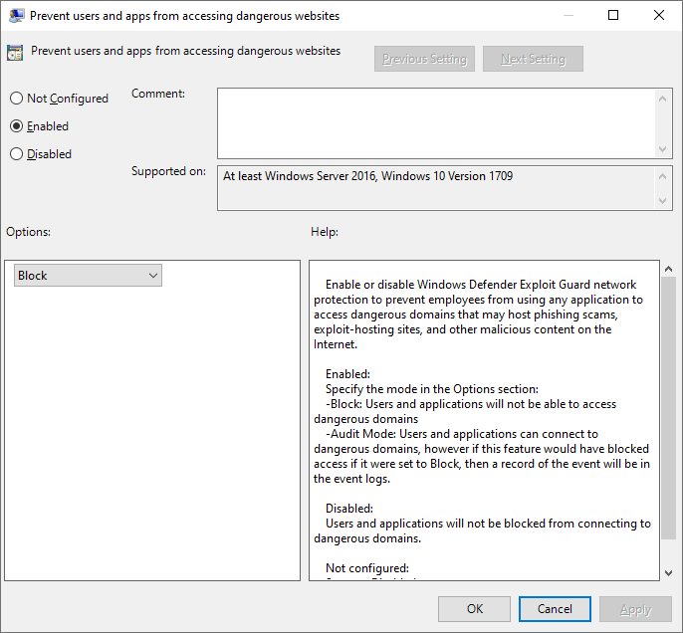
Configure Network Protection
Set-MpPreference -EnableNetworkProtection Enabled
-Block: Users and applications will not be able to access dangerous domains
-Audit Mode: Users and applications can connect to dangerous domains, however if this feature would have blocked access if it were set to Block, then a record of the event will be in the event logs.

Slide 42
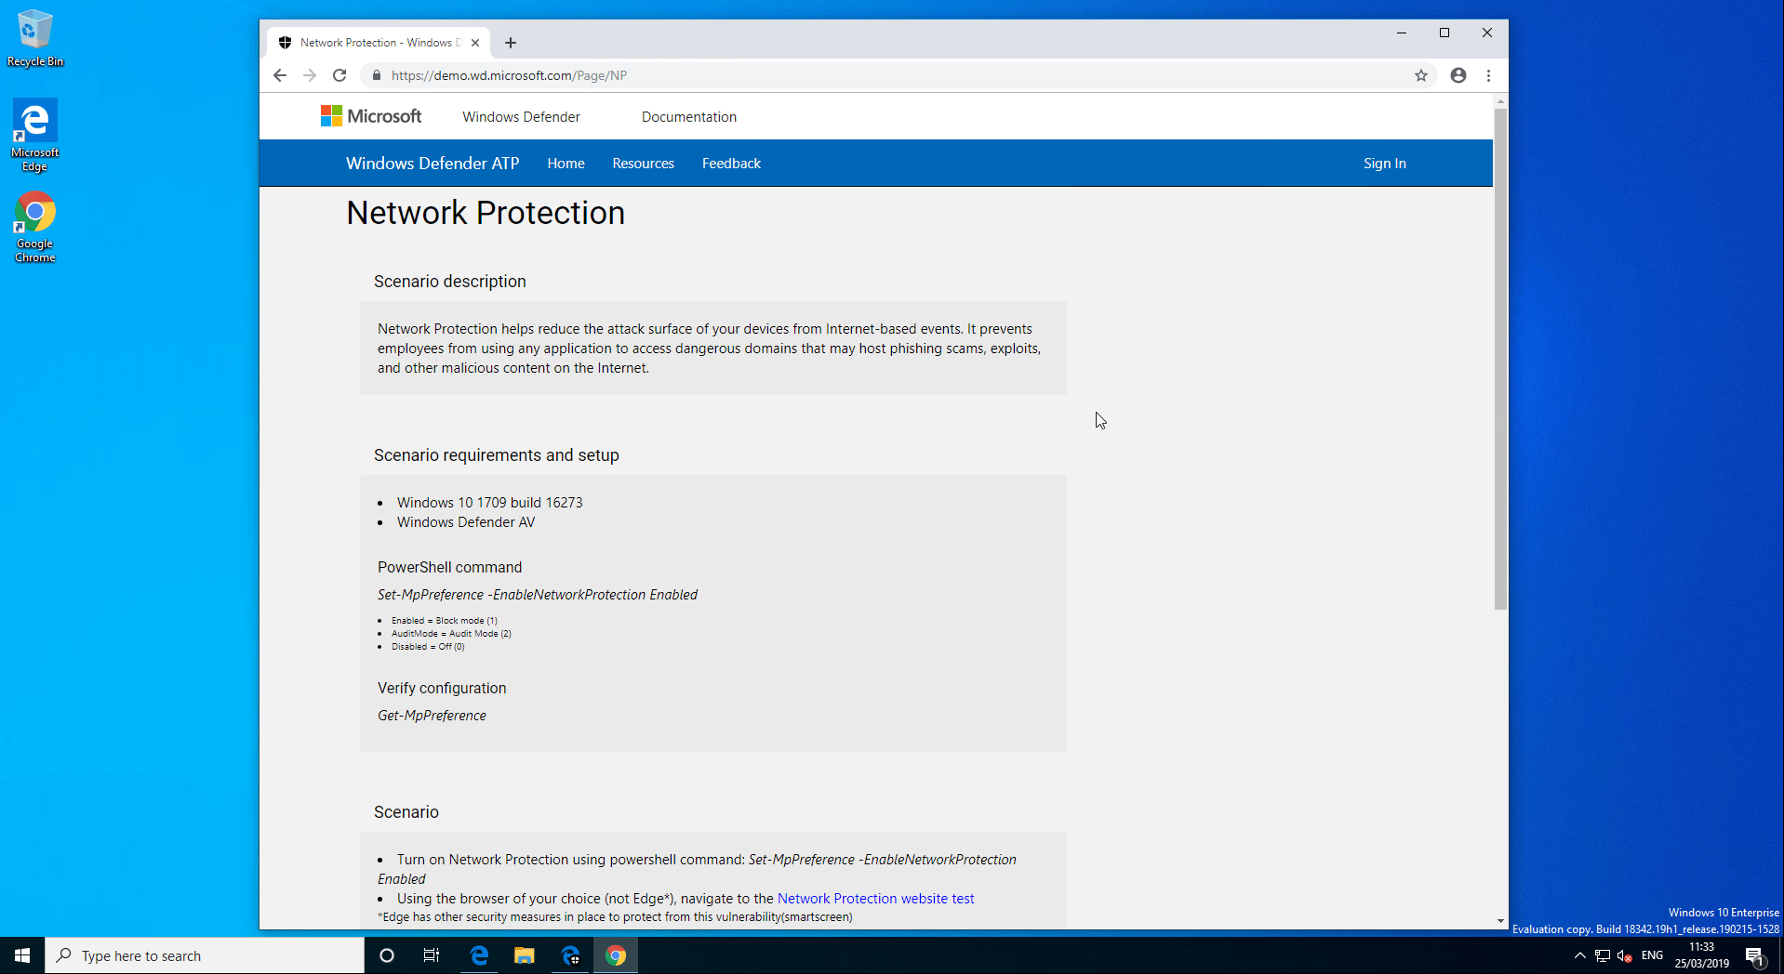

Slide 43
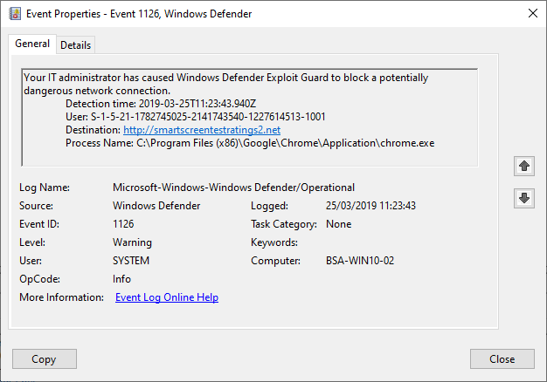

Exploit Guard Network Protection Event Logs

Slide 44
Controlled Folder Access
Protect files/directories from malicious tampering, e.g ransomware
Latest versions also allow us to protect disk sectors as well (e.g boot)
“All apps (any executable file, including .exe, .scr, .dll files and others) are assessed by Windows Defender Antivirus, which then determines if the app is malicious or safe. If the app is determined to be malicious or suspicious, then it will not be allowed to make changes to any files in any protected folder.”
Set-MpPreference -EnableControlledFolderAccess Enabled

Slide 45
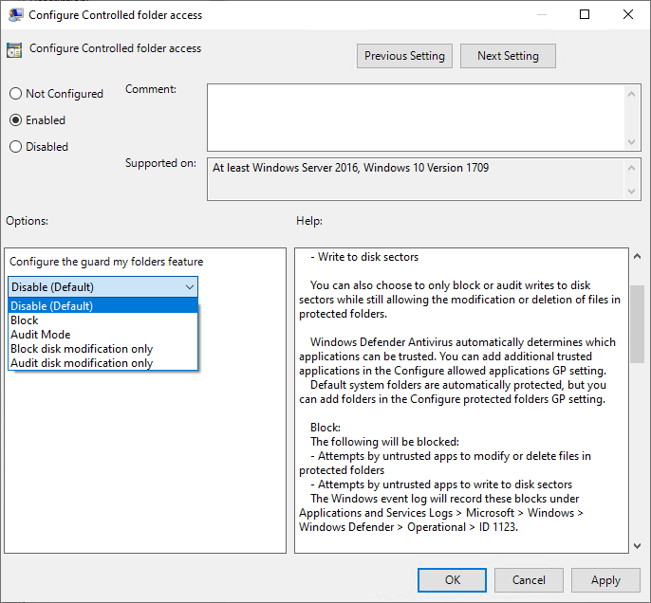
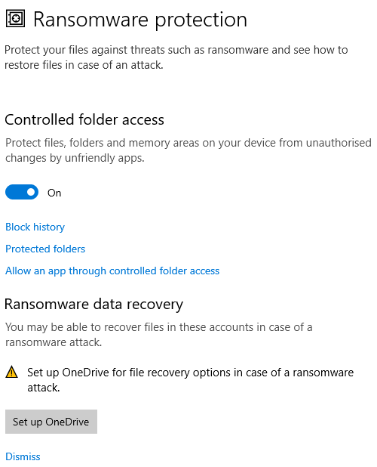

Slide 46
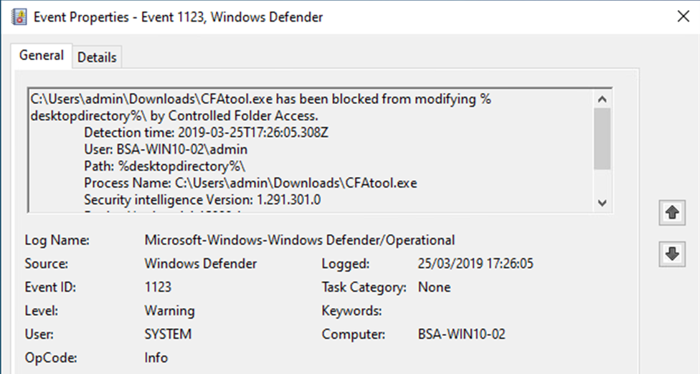
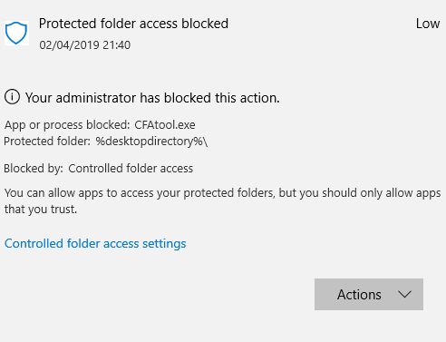
Exploit Guard CFA Event Logs

Slide 47


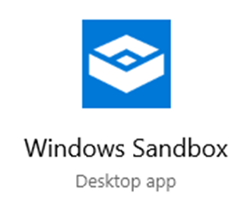
Windows Sandbox
Insider Preview build only at time of writing

Slide 48
Windows Sandbox - Microsoft Blurb…
Part of Windows
Everything required for this feature ships with Windows 10 Pro and Enterprise. No need to download a VHD!
Pristine
Every time Windows Sandbox runs, it’s as clean as a brand-new installation of Windows
Disposable
Nothing persists on the device; everything is discarded after you close the application
Secure
Uses hardware-based virtualization for kernel isolation, which relies on the Microsoft’s hypervisor to run a separate kernel which isolates Windows Sandbox from the host
Efficient
Uses integrated kernel scheduler, smart memory management, and virtual GPU
“Treat the sandbox like an app but with the isolation of a virtual machine”
Reference: https://techcommunity.microsoft.com/t5/Windows-Kernel-Internals/Windows-Sandbox/ba-p/301849

Slide 49
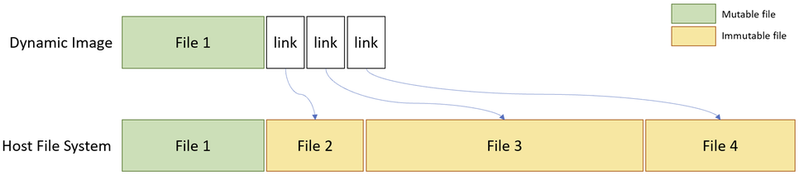
Windows Sandbox Image
The sandbox OS contains ‘clean copies’ of files that might change and simply references all other immutable files on the existing installation
Memory sharing also occurs in a similar fashion
By being smart about the way we share immutable resources we can keep the image tiny while still providing a full Windows sandbox, awesome!
Reference: https://techcommunity.microsoft.com/t5/Windows-Kernel-Internals/Windows-Sandbox/ba-p/301849

Slide 50
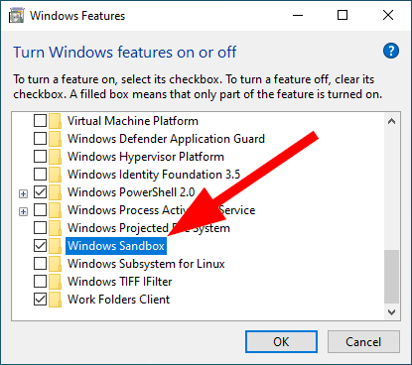
Windows Sandbox Requirements
Windows 10 Pro or Enterprise Insider build 18305 or later
x64 architecture
Virtualization capabilities enabled in BIOS/EFI
At least 4GB of RAM (8GB recommended)
At least 1 GB of free disk space (SSD recommended)
At least 2 CPU cores (4 cores with hyperthreading recommended)
Requirements are not that restrictive considering modern hardware
Reference: https://techcommunity.microsoft.com/t5/Windows-Kernel-Internals/Windows-Sandbox/ba-p/301849

Slide 51
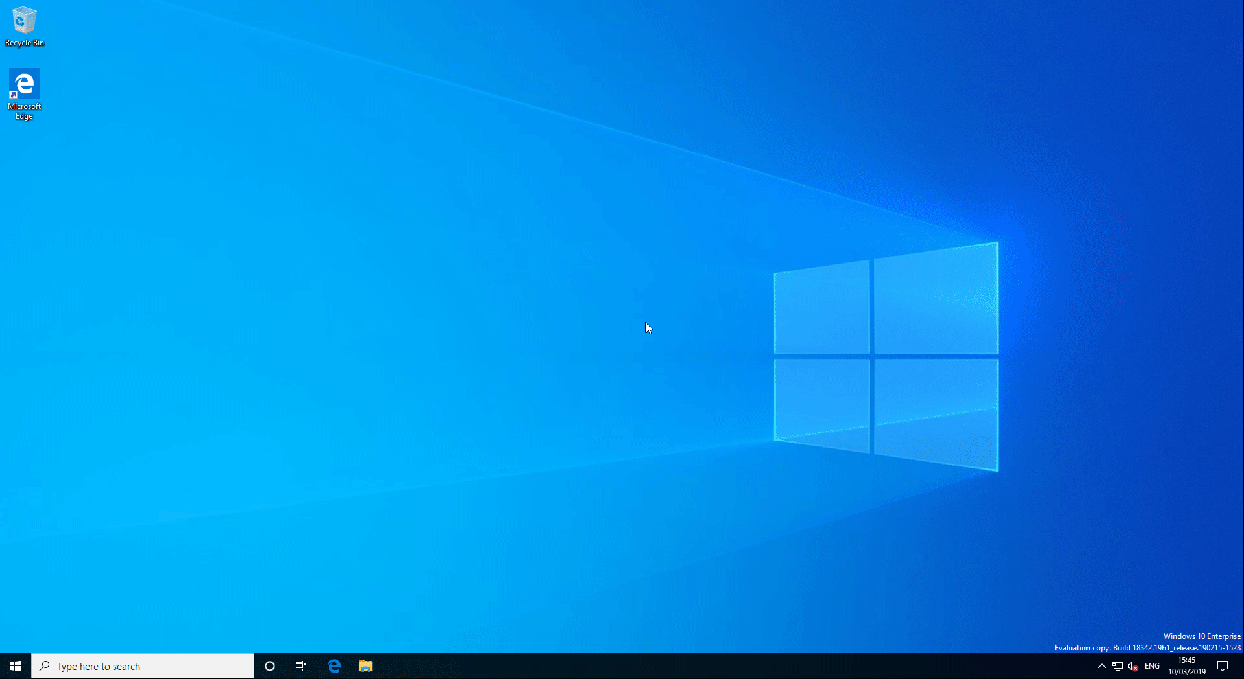

Slide 52
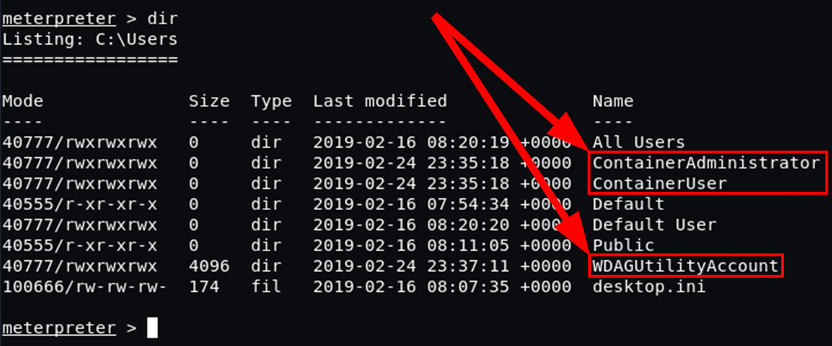
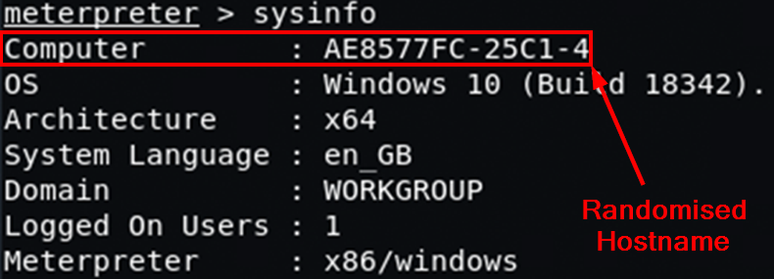
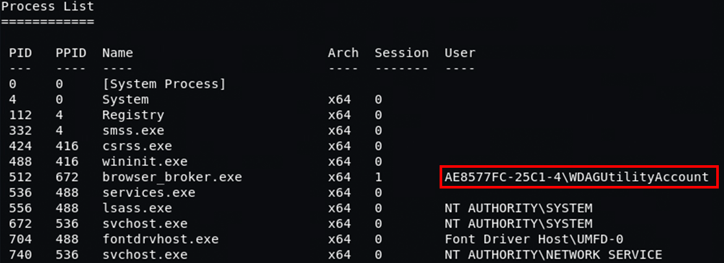
Metasploit Compromised Sandbox

Slide 53
AppLocker & Device Guard – Whitelisting
Windows 10 offers both AppLocker and Device Guard for application whitelisting
AppLocker has existed for many years and has no special hardware requirements
Device Guard is newer and does require certain hardware/OS setup to work and be most effective
Microsoft are now calling it Windows Defender Application Control (WDAC)
I’ll use the terms interchangeably

Slide 54
Device Guard (Windows Defender Application Control)
Based on Code Integrity (CI) policies
Microsoft provide recommended block list which can be merged with your own policy - https://docs.microsoft.com/en-gb/windows/security/threat-protection/windows-defender-application-control/microsoft-recommended-block-rules
Leverages VSM/VBS to place Device Guard in IUM
Uses Windows Code Integrity Services
Kernel-Mode Code Signing (KMCS)
User-Mode Code Integrity (UMCI)
Can leverage Hypervisor Code Integrity (HVCI)
I’ll refer to WDAC as Device Guard just from habit but do note that Microsoft have changed the name, no doubt the marketing people got involved ☺

Slide 55
AppLocker vs Device Guard
 | AppLocker | Device Guard
Scope | USER MODE | USER MODE KERNEL MODE
Local Admin Overrides | YES | NO (with correct config)
Hardware Requirements | NONE | YES (kind of)
Risk of bricking yourself | LOW | CAN BE HIGH

Slide 56
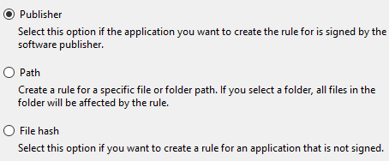
AppLocker Rules
3 types of rule
Directory Path
Publisher (digital signature/certificate based)
File Hash (SHA2)
Use AaronLocker to help build appropriate ruleset – much faster and more robust - https://github.com/Microsoft/AaronLocker
Can be configured to control non-interactive processes as well
Start with AUDIT mode then move to ENFORCED

Slide 57
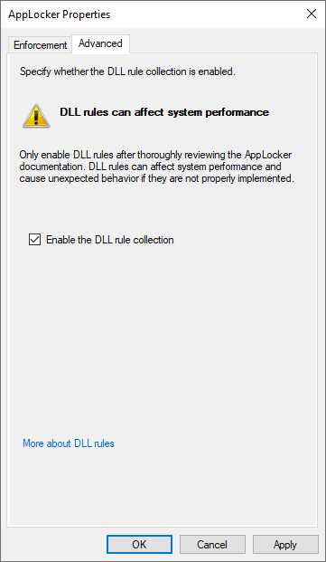
AppLocker DLL Rules
The Group Policy console really doesn’t want you enabling!
Aaron Margosis (Microsoft AppLocker guru) advice is to ENABLE
Of course you should test on your standard build

Slide 58
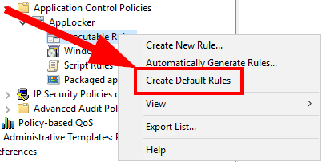
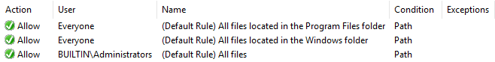
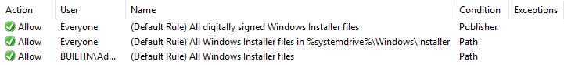
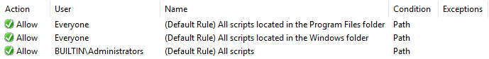
AppLocker Default Rules
Quick way to get started!
Executable Rules
Windows Installer
Script

Slide 59
DG/WDAC Hardware Requirements
You can benefit from Code Integrity (CI) policies without requiring full VBS support on your hardware
This means you can deploy DG/WDAC without but the recommendation is you have systems which meet the necessary hardware/firmware/kernel driver requirements
https://docs.microsoft.com/en-us/windows/security/threat-protection/device-guard/introduction-to-device-guard-virtualization-based-security-and-windows-defender-application-control

Slide 60
DG/WDAC Signed Policy
We can sign our DG/WDAC policy to prevent users with administrator rights or kernel mode code from modifying or removing the policy
This makes it much harder to try and tamper with a CI policy but it also means you need to be extra careful so as not to cause problems for yourself!

Slide 61
AppLocker, Device Guard or Both?
Microsoft recommend running both
AppLocker gives us the flexibility to create policies on the same machine for different users
DG/WDAC provides much greater control over the system as a whole
https://docs.microsoft.com/en-gb/windows/security/threat-protection/windows-defender-application-control/windows-defender-device-guard-and-applocker

Slide 62
National Cyber Security Centre - NCSC
“Launched in October 2016, the NCSC has headquarters in London and brought together expertise from CESG (the information assurance arm of GCHQ), the Centre for Cyber Assessment, CERT-UK, and the Centre for Protection of National Infrastructure”
Excellent resource for security guidance – they create recommendation documents for Windows 10 configuration (regularly updated with each release)
Windows 10 1809 - https://www.ncsc.gov.uk/collection/end-user-device-security?curPage=/collection/end-user-device-security/platform-specific-guidance/eud-security-guidance-windows-10-1809
https://www.ncsc.gov.uk/section/advice-guidance/all-topics

Slide 63

Questions

Slide 64

Feedback
Feedback is truly valued; either directly or via the team at TechUG
Slides available: ByteSizedAlex.com & GitHub.com/bytesizedalex

Slide 65
Appendices

Slide 66
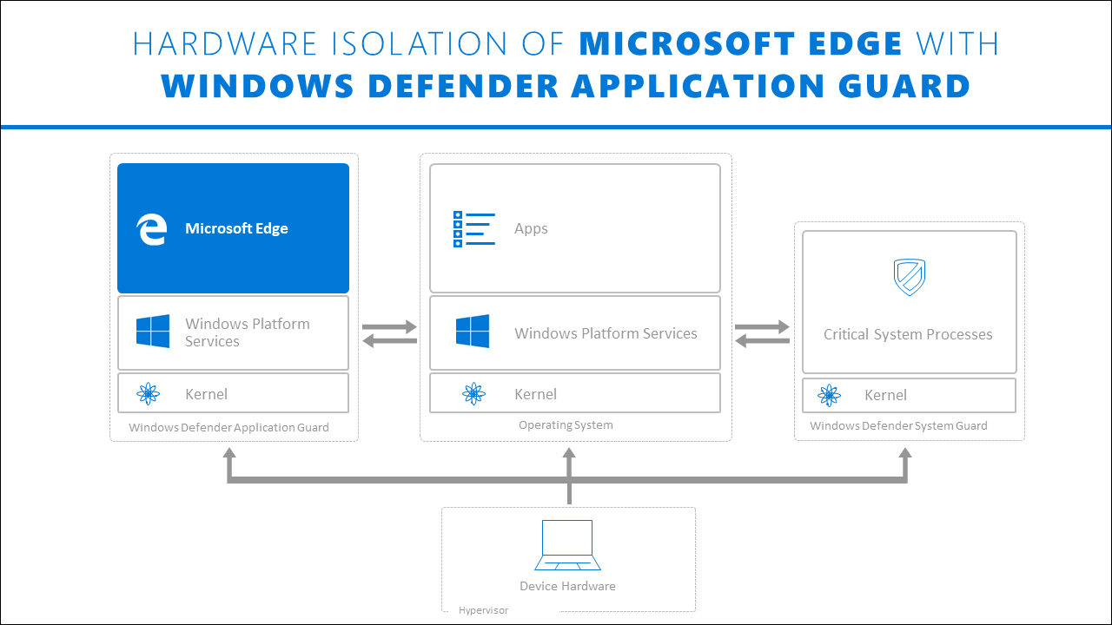
Reference: https://docs.microsoft.com/en-us/windows/security/threat-protection/windows-defender-application-guard/wd-app-guard-overview

Slide 67
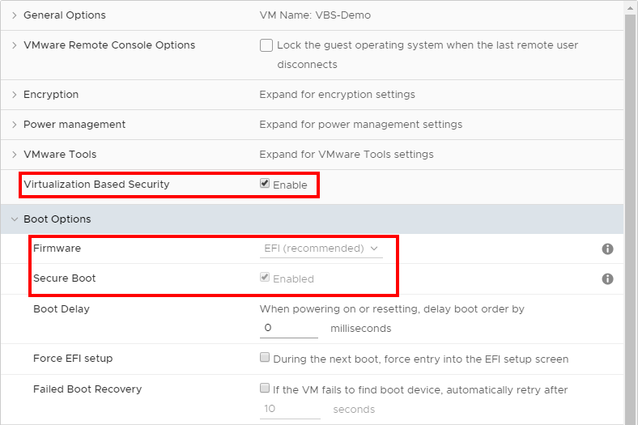
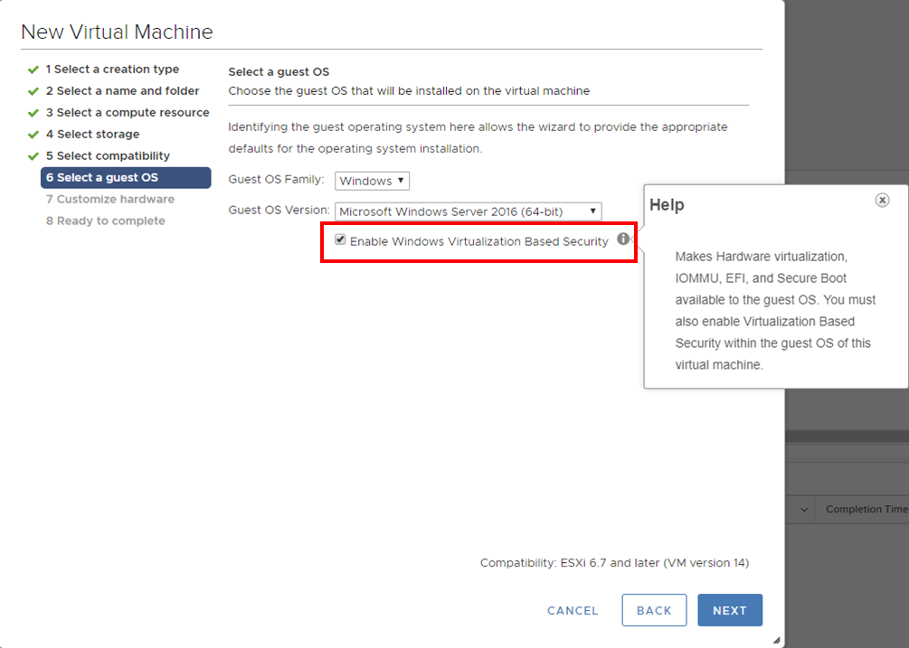
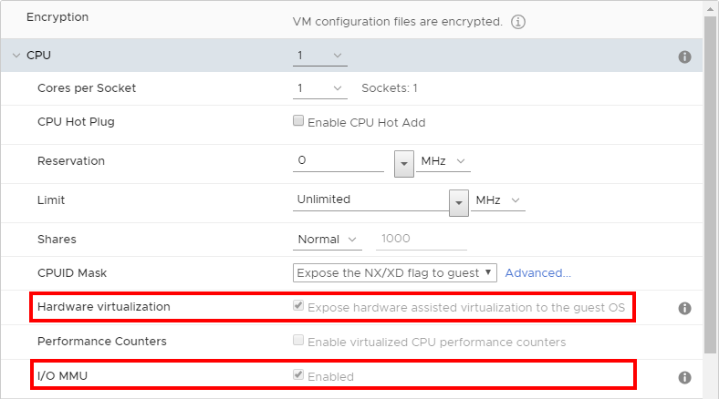
VMware vCenter - Enable VBS (ESXi 6.7 or later)
Enabling VBS will enforce required settings and prevent you changing them

Slide 68
Hyper-V Enabled Nested Virtualisation
PowerShell
Set-VMProcessor -VMName 'MyTest-VM' -ExposeVirtualizationExtensions $true

Slide 69
AppLocker Rule Notes
AppLocker rule limitations
The more rules per GPO, the longer AppLocker requires for evaluation. There is no set limitation on the number of rules per GPO, but the number of rules that can fit into a 100 MB GPO varies based on the complexity of the rule, such as the number of file hashes included in a single file hash condition
Windows Server 2008 R2, GPOs have a 2 MB size limit for performance. In subsequent versions, that limit is raised to 100 MB.
Using the DLL rule collection
When the DLL rule collection is enabled, AppLocker must check each DLL that an application loads. The more DLLs, the longer AppLocker requires to complete the evaluation
Reference: https://docs.microsoft.com/en-us/windows/security/threat-protection/windows-defender-application-control/applocker/optimize-applocker-performance

Slide 70
Secure Boot Requirements
Hardware requirement | Details
UEFI Version 2.3.1 Errata C variables | Variables must be set to SecureBoot=1 and SetupMode=0 with a signature database (EFI_IMAGE_SECURITY_DATABASE) necessary to boot the machine securely pre-provisioned, and including a PK that is set in a valid KEK database. For more information, see System.Fundamentals.Firmware.UEFISecureBoot
UEFI v2.3.1 Section 27 | The platform must expose an interface that adheres to the profile of UEFI v2.3.1 Section 27
UEFI signature database | The platform must come provisioned with the correct keys in the UEFI Signature database (db) to allow Windows to boot. It must also support secure authenticated updates to the databases. Storage of secure variables must be isolated from the running operating system such that they cannot be modified without detection
Firmware signing | All firmware components must be signed using at least RSA-2048 with SHA-256
Boot manager | When power is turned on, the system must start executing code in the firmware and use public key cryptography as per algorithm policy to verify the signatures of all images in the boot sequence, up to and including the Windows Boot Manager
Rollback protection | The system must protect against rollback of firmware to older versions
EFI_HASH_PROTOCOL | The platform provides the EFI_HASH_PROTOCOL (per UEFI v2.3.1) for offloading cryptographic hash operations and the EFI_RNG_PROTOCOL (Microsoft defined) for accessing platform entropy
Reference: https://docs.microsoft.com/en-us/windows-hardware/design/device-experiences/oem-secure-boot#secure-boot-requirements

Slide 71
VBS Requirements
Hardware requirement | Details
64-bit CPU | Virtualization-based security (VBS) requires the Windows hypervisor, which is only supported on 64-bit IA processors with virtualization extensions, including Intel VT-X and AMD-v.
Second Level Address Translation (SLAT) | VBS also requires that the processor’s virtualization support includes Second Level Address Translation (SLAT), either Intel VT-X2 with Extended Page Tables (EPT), or AMD-v with Rapid Virtualization Indexing (RVI).
IOMMUs or SMMUs (Intel VT-D, AMD-Vi, ARM64 SMMUs) | All I/O devices capable of DMA must be behind an IOMMU or SMMU. An IOMMU can be used to enhance system resiliency against memory attacks.
Trusted Platform Module 2.0 | TPMs, either discrete or firmware, will suffice. For more information, see Trusted Platform Module (TPM) 2.0.
Firmware support for SMM protection | System firmware must adhere to the recommendations for hardening SMM code described in the Windows SMM Security Mitigations Table (WMST) specification. The WSMT specification contains details of an ACPI table that was created for use with Windows operating systems that support Windows virtualization-based security (VBS) features. Firmware must implement the protections described in the WSMT specification, and set the corresponding protection flags as described in the specification to report compliance with these requirements to the operating system.
Unified Extensible Firmware Interface (UEFI) Memory Reporting | UEFI firmware must adhere to the following memory map reporting format and memory allocation guidelines in order for firmware to ensure compatibility with VBS. UEFI v2.6 Memory Attributes Table (MAT) - To ensure compatibility with VBS, firmware must cleanly separate EFI runtime memory ranges for code and data, and report this to the operating system. Proper segregation and reporting of EFI runtime memory ranges allows VBS to apply the necessary page protections to EFI runtime services code pages within the VBS secure region. Conveying this information to the OS is accomplished using the EFI_MEMORY_ATTRIBUTES_TABLE. To implement the UEFI MAT, follow these guidelines: The entire EFI runtime must be described by this table. All appropriate attributes for EfiRuntimeServicesData and EfiRuntimeServicesCode pages must be marked. These ranges must be aligned on page boundaries (4KB), and can not overlap. EFI Page Protections -All entries must include attributes EFI_MEMORY_RO, EFI_MEMORY_XP, or both. All UEFI memory that is marked executable must be read only. Memory marked writable must not be executable. Entries may not be left with neither of the attributes set, indicating memory that is both executable and writable.
Secure Memory Overwrite Request (MOR) revision 2 | Secure MOR v2 is enhanced to protect the MOR lock setting using a UEFI secure variable. This helps guard against advanced memory attacks. For details, see Secure MOR implementation.
Hypervisor Code Integrity (HVCI)-compatible drivers | Ensure all system drivers have been tested and verified to be compatible with HVCI. The Windows Driver Kit and Driver Verifier contain tests for driver HVCI compatibility. There are four steps to verify driver compatibility: Use Driver Verifier with the new Code Integrity compatibility checks enabled. Run the Hypervisor Code Integrity Readiness Test in the Windows HLK. Test the driver on a system with VBS and HVCI enabled. This step is imperative to validate the driver's behaviour with HVCI, as static code analysis tools simply aren't capable of detecting all HVCI violations possible at runtime. Use the Device Guard and Credential Guard hardware readiness tool.

Slide 72
Standard Remote Desktop vs Remote Credential Guard/Restricted Admin Mode
Feature | Remote Desktop | Windows Defender Remote Credential Guard | Restricted Admin mode
Protection benefits | Credentials on the server are not protected from Pass-the-Hash attacks. | User credentials remain on the client. An attacker can act on behalf of the user only when the session is ongoing | User logs on to the server as local administrator, so an attacker cannot act on behalf of the “domain user”. Any attack is local to the server
Version support | The remote computer can run any Windows operating system | Both the client and the remote computer must be running at least Windows 10, version 1607, or Windows Server 2016. | The remote computer must be running at least patched Windows 7 or patched Windows Server 2008 R2. For more information about patches (software updates) related to Restricted Admin mode, see Microsoft Security Advisory 2871997.
Helps prevent | N/A | Pass-the-Hash Use of a credential after disconnection | Pass-the-Hash Use of domain identity during connection
Credentials supported from the remote desktop client device | Signed on credentials Supplied credentials Saved credentials | Signed on credentials only | Signed on credentials Supplied credentials Saved credentials
Access | Users allowed, that is, members of Remote Desktop Users group of remote host. | Users allowed, that is, members of Remote Desktop Users of remote host. | Administrators only, that is, only members of Administrators group of remote host.
Network identity | Remote Desktop session connects to other resources as signed-in user. | Remote Desktop session connects to other resources as signed-in user. | Remote Desktop session connects to other resources as remote host’s identity.
Multi-hop | From the remote desktop, you can connect through Remote Desktop to another computer | From the remote desktop, you can connect through Remote Desktop to another computer. | Not allowed for user as the session is running as a local host account
Supported authentication | Any negotiable protocol. | Kerberos only. | Any negotiable protocol

Slide 73
Device Guard Requirements
Requirement | Details
Secure Boot | Hardware-based Secure Boot must be supported. To learn more, see Secure Boot
Secure Boot configuration and management | The OEM has to be able to add ISV, OEM, or Enterprise Certificate in Secure Boot DB at manufacturing time. Microsoft UEFI CA must be removed from Secure Boot DB. Support for 3rd-party UEFI modules is permitted but should leverage ISV-provided certificates or OEM certificate for the specific UEFI software
Secure firmware update process | Like UEFI software, UEFI firmware can have security vulnerabilities. It is essential to have the capability to immediately patch such vulnerabilities when found through firmware updates. UEFI firmware must support secure firmware update following Hardware Compatibility Specification for Systems for Windows 10 under System.Fundamentals.Firmware.UEFISecureBoot
Trusted Platform Module (TPM) | To learn more about TPM, see Trusted Platform Module
United Extensible Firmware Interface (UEFI) | To learn more, see United Extensible Firmware Interface (UEFI) firmware requirements
Virtualization-based security (VBS) | Device Guard requires VBS. You can learn more about VBS by reading Virtualization-based Security (VBS)

Slide 74
WDAG Hardware Requirements
Hardware | Description
64-bit CPU | A 64-bit computer with minimum 4 cores (logical processors) is required for hypervisor and virtualization-based security (VBS). For more info about Hyper-V, see Hyper-V on Windows Server 2016 or Introduction to Hyper-V on Windows 10. For more info about hypervisor, see Hypervisor Specifications.
CPU virtualization extensions | Extended page tables, also called Second Level Address Translation (SLAT) -AND- One of the following virtualization extensions for VBS: VT-x (Intel) -OR- AMD-V
Hardware memory | Microsoft requires a minimum of 8GB RAM
Hard disk | 5 GB free space, solid state disk (SSD) recommended
Input/Output Memory Management Unit (IOMMU) support | Not required, but strongly recommended
Reference: https://docs.microsoft.com/en-us/windows/security/threat-protection/windows-defender-application-guard/reqs-wd-app-guard

Slide 75
WDAG Software Requirements
Software | Description
Operating system | Windows 10 Enterprise edition, version 1709 or higher Windows 10 Professional edition, version 1803
Browser | Microsoft Edge and Internet Explorer
Management system (only for managed devices) | Microsoft Intune -OR- System Center Configuration Manager -OR- Group Policy -OR- Your current company-wide 3rd party mobile device management (MDM) solution. For info about 3rd party MDM solutions, see the documentation that came with your product.
Reference: https://docs.microsoft.com/en-us/windows/security/threat-protection/windows-defender-application-guard/reqs-wd-app-guard

Slide 76
Exploit Guard Attack Surface Reduction (ASR) rules
Rule name | GUID
Block executable content from email client and webmail | BE9BA2D9-53EA-4CDC-84E5-9B1EEEE46550
Block all Office applications from creating child processes | D4F940AB-401B-4EFC-AADC-AD5F3C50688A
Block Office applications from creating executable content | 3B576869-A4EC-4529-8536-B80A7769E899
Block Office applications from injecting code into other processes | 75668C1F-73B5-4CF0-BB93-3ECF5CB7CC84
Block JavaScript or VBScript from launching downloaded executable content | D3E037E1-3EB8-44C8-A917-57927947596D
Block execution of potentially obfuscated scripts | 5BEB7EFE-FD9A-4556-801D-275E5FFC04CC
Block Win32 API calls from Office macro | 92E97FA1-2EDF-4476-BDD6-9DD0B4DDDC7B
Block executable files from running unless they meet a prevalence, age, or trusted list criterion | 01443614-cd74-433a-b99e-2ecdc07bfc25
Use advanced protection against ransomware | c1db55ab-c21a-4637-bb3f-a12568109d35
Block credential stealing from the Windows local security authority subsystem (lsass.exe) | 9e6c4e1f-7d60-472f-ba1a-a39ef669e4b2
Block process creations originating from PSExec and WMI commands | d1e49aac-8f56-4280-b9ba-993a6d77406c
Block untrusted and unsigned processes that run from USB | b2b3f03d-6a65-4f7b-a9c7-1c7ef74a9ba4
Block Office communication application from creating child processes | 26190899-1602-49e8-8b27-eb1d0a1ce869
Block Adobe Reader from creating child processes | 7674ba52-37eb-4a4f-a9a1-f0f9a1619a2c
Reference: https://docs.microsoft.com/en-us/windows/security/threat-protection/windows-defender-exploit-guard/attack-surface-reduction-exploit-guard

Slide 77
TPM and Windows Features
Windows Features | TPM Required | Supports TPM 1.2 | Supports TPM 2.0 | Details
Measured Boot | Yes | Yes | Yes | Measured Boot requires TPM 1.2 or 2.0 and UEFI Secure Boot
BitLocker | Yes | Yes | Yes | TPM 1.2 or 2.0 is required, but Automatic Device Encryption requires Modern Standby including TPM 2.0 support
Device Encryption | Yes | N/A | Yes | Device Encryption requires Modern Standby/Connected Standby certification, which requires TPM 2.0.
Windows Defender Application Control (Device Guard) | No | Yes | Yes
Windows Defender Exploit Guard | No | N/A | N/A
Windows Defender System Guard | Yes | No | Yes
Credential Guard | No | Yes | Yes | Windows 10, version 1507 (End of Life as of May 2017) only supported TPM 2.0 for Credential Guard. Beginning with Windows 10, version 1511, TPM 1.2 and 2.0 are supported.
Device Health Attestation | Yes | Yes | Yes
Windows Hello/Windows Hello for Business | No | Yes | Yes | Azure AD join supports both versions of TPM, but requires TPM with keyed-hash message authentication code (HMAC) and Endorsement Key (EK) certificate for key attestation support.
UEFI Secure Boot | No | Yes | Yes
TPM Platform Crypto Provider Key Storage Provider | Yes | Yes | Yes
Virtual Smart Card | Yes | Yes | Yes
Certificate storage | No | Yes | Yes | TPM is only required when the certificate is stored in the TPM.
Autopilot | Yes | No | Yes | TPM 2.0 and UEFI firmware is required.
SecureBIO | Yes | No | Yes | TPM 2.0 and UEFI firmware is required.
DRTM | Yes | No | Yes | TPM 2.0 and UEFI firmware is required.

Slide 78
